Slide 1
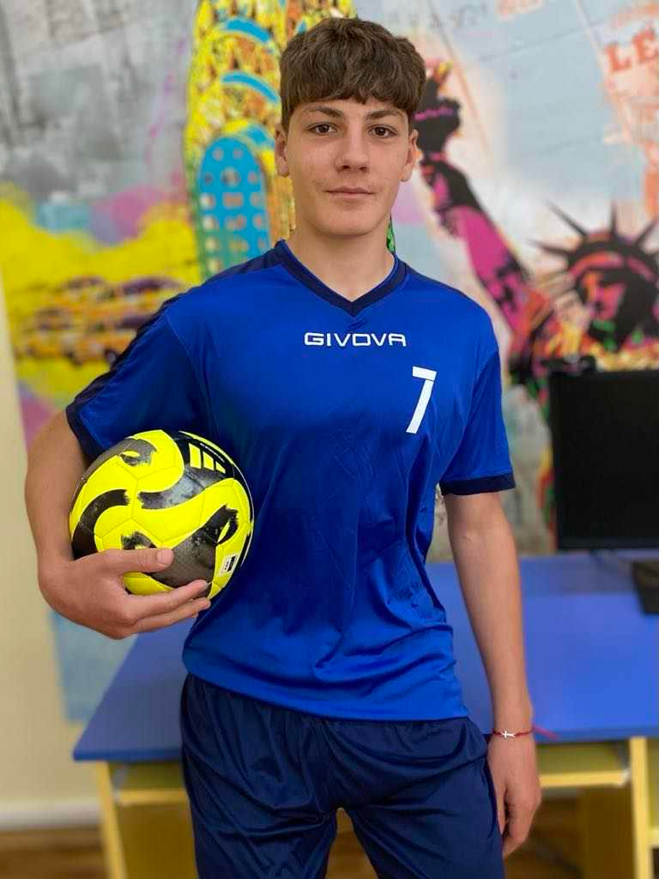
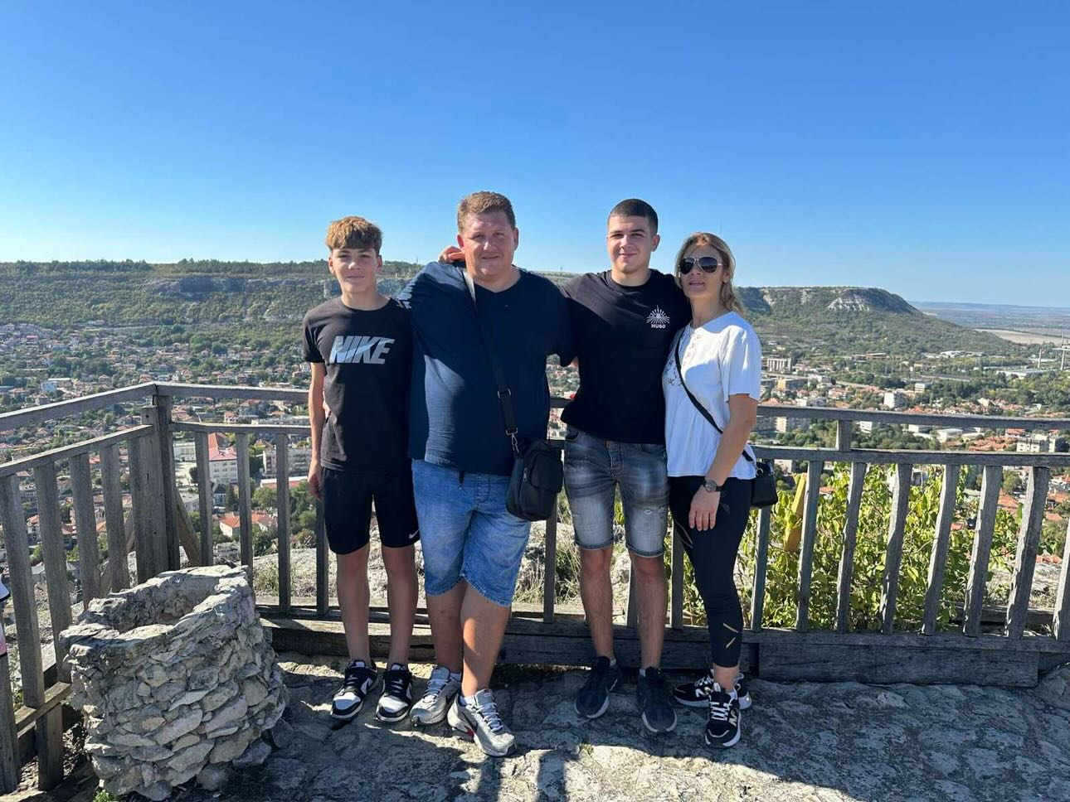
ME AND MY FAMILY
My name is Stanislav Nikolov.
I am 15 years old and I live in the town of
Dobrich. I live with my parents, Zhivko and Maria, and my older brother Ivelin.

Slide 2
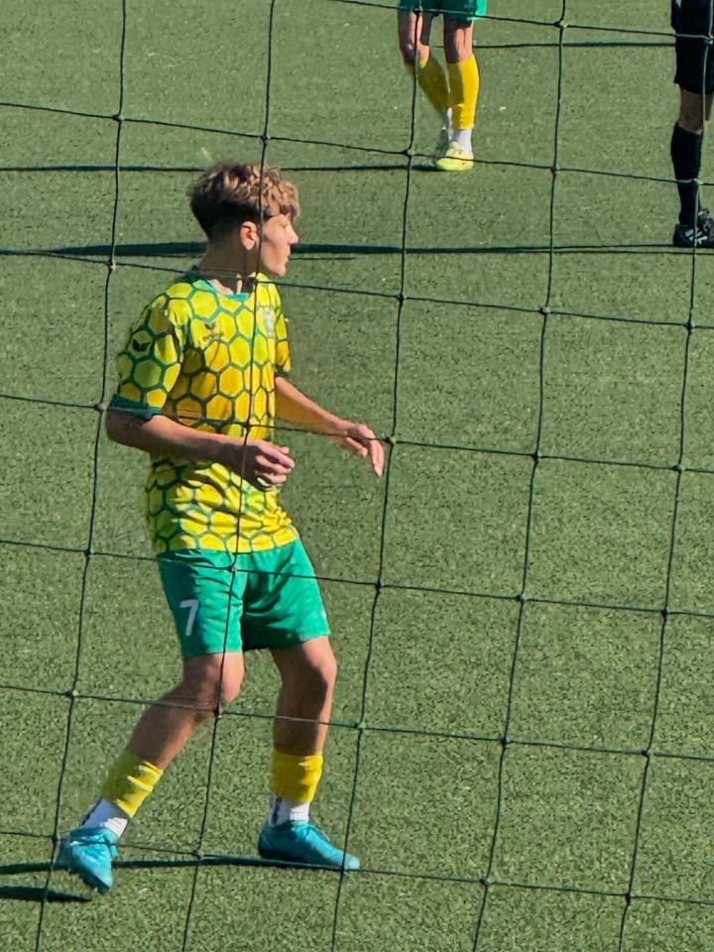
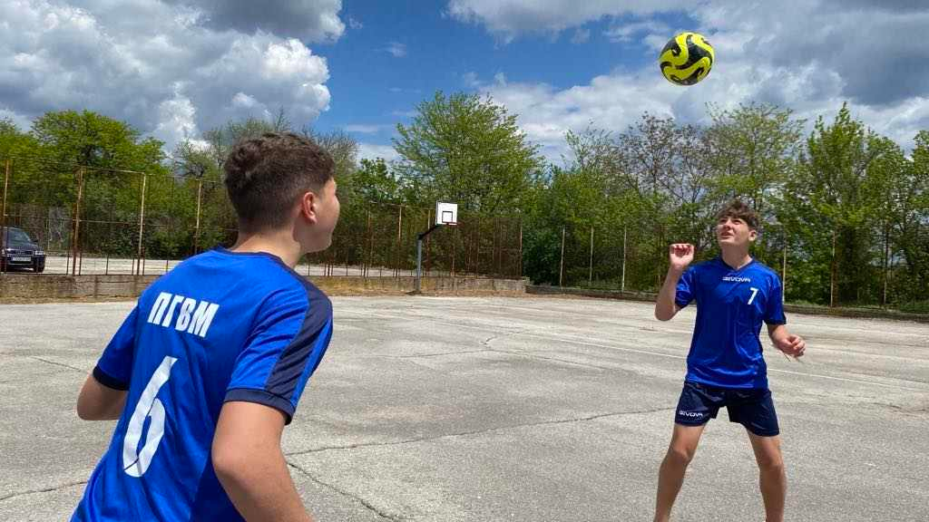
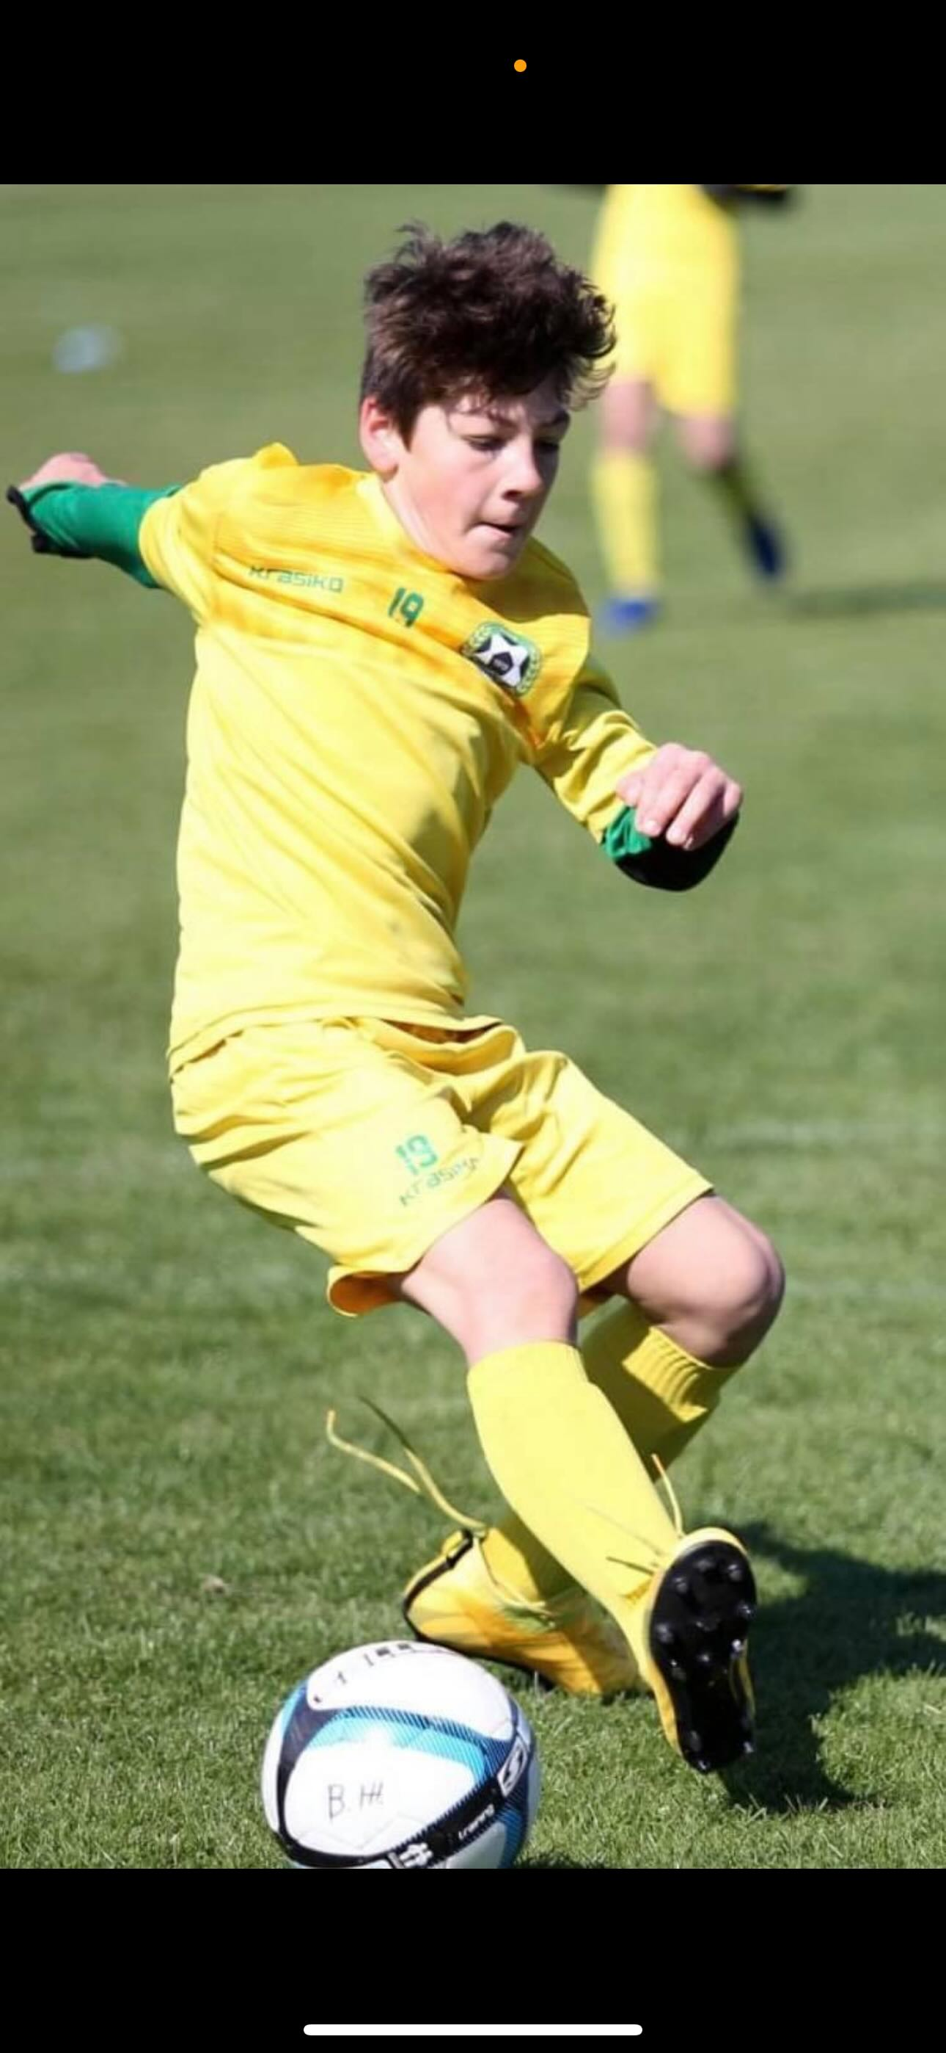
MY PASSION FOR FOOTBALL
I began playing football at the age of five at the Dobrudja.
I play both as a right and left winger. My favorite team
is Bayern Munich, and my favorite player is Vinicius Junior.

