Slide 1
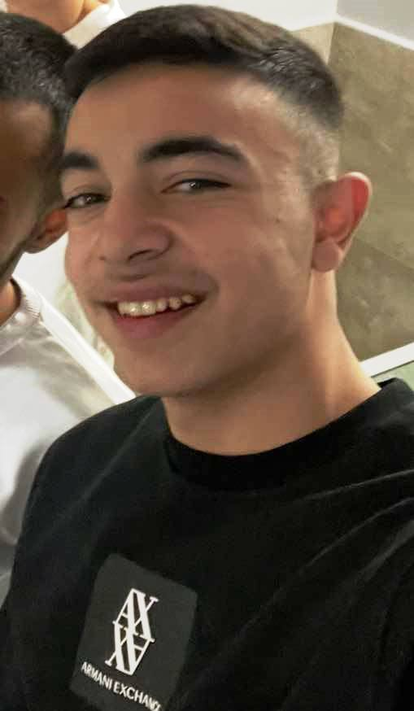
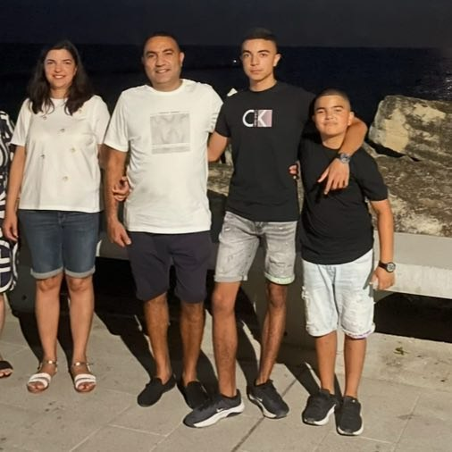
My name is Sezgin Ertan. I live in Dobrich with my family. My dream is to become famous one day, and I love all sports - especially football!

Slide 2
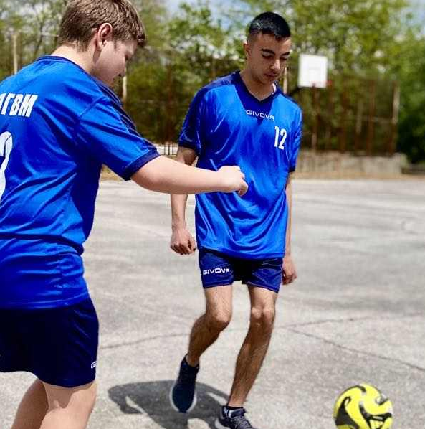

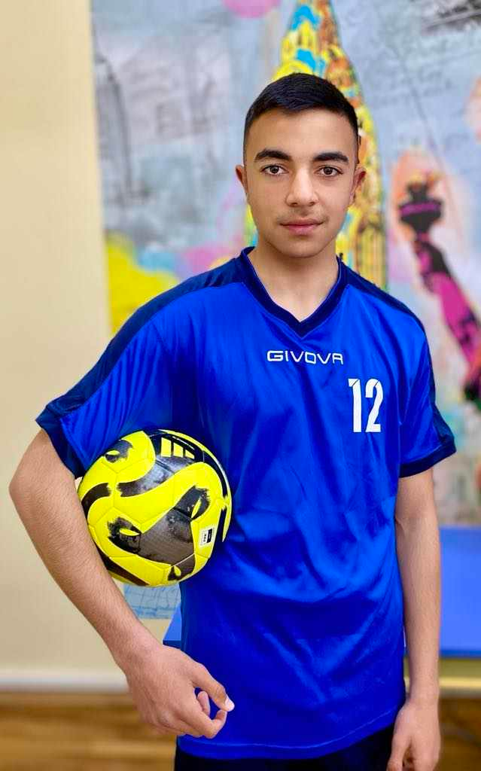

My favorite football team is the White Ballet – Real Madrid. I admire their rich history, countless trophies, and playing style full of class and passion. My favorite footballer is Neymar - I love his technique, creativity, and ability to change the outcome of a match with a single touch.

