Slide 1
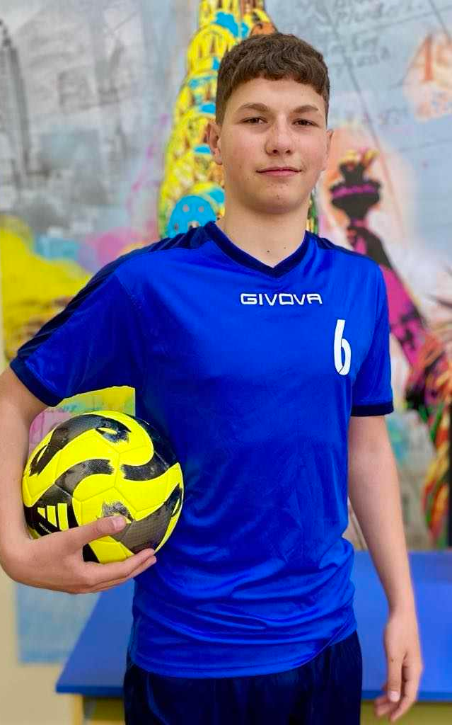
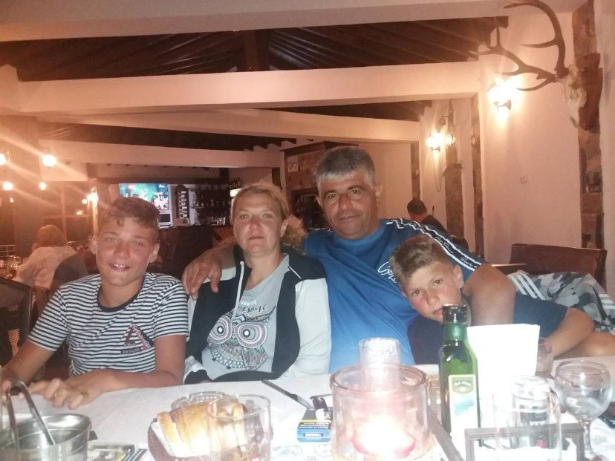
My name is Alexander Katrandzhiev, and I’m a 16-year-old from Dobrich, Bulgaria. In my free time, I love playing football and spending time with my friends.

Slide 2
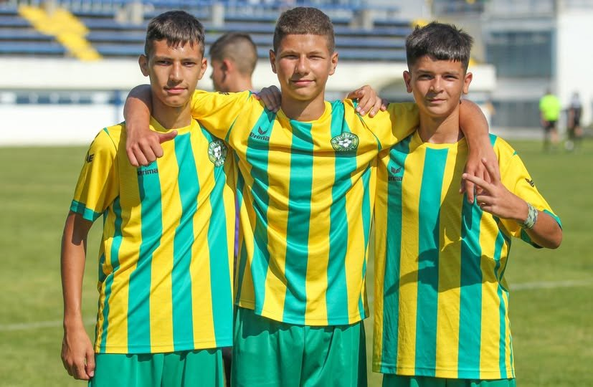
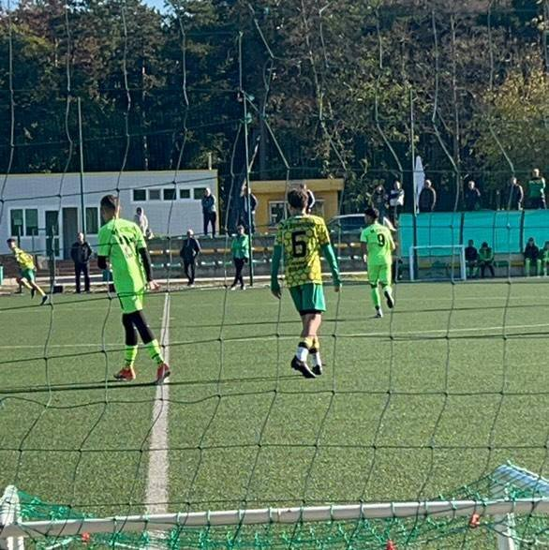
I’ve been training in football for 8 years, and to me, it’s more than just a game - it’s a way of life. I play for Cherno More.
My favorite player is Cole Palmer. His creativity and determination really inspire me. I’m also a loyal fan of Chelsea FC, and one of my biggest dreams is to play one day in a stadium full of cheering fans, wearing the blue jersey of my favorite club.

