Slide 1
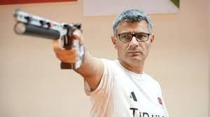
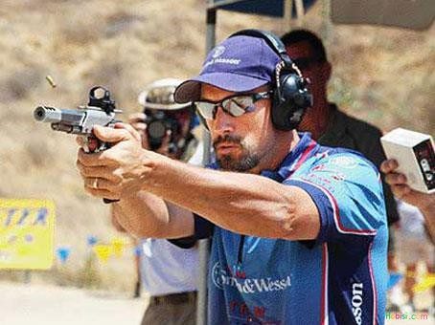
Ali Mert Kolcu 11/A
Gençlerbirliği Sports High School
🠶 Pistol shooting sport;
🠶Pistol shooting is an Olympic sport in which athletes shoot at stationary targets from specific distances, requiring high concentration, balance, and technique. Mental endurance, breath control, and stability are more important than physical strength.
🠶 History;
🠶 The origins of shooting sports date back to the 15th century. It became a sport in its modern
sense in the 19th century. It has been an Olympic sport since the 1896 Athens Olympics. Over time, safety, standards, and electronic target systems have improved.

Slide 2
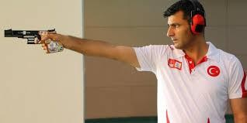
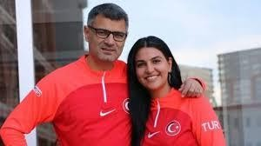
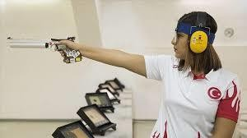
🠶 Shooting in Turkey;
🠶 Shooting in Turkey is managed by the Turkish Shooting and Hunting Federation.
🠶 It has shown significant development in recent years.
🠶 Yusuf Dikeç is one of the most well-known athletes in Turkish shooting.
🠶 At the Paris 2024 Olympics, Yusuf Dikeç and Şevval İlayda Tarhan won a silver medal in the 10-meter air pistol mixed team category, bringing Turkey its first Olympic medal in this discipline.
🠶 This success greatly increased interest in shooting sports in Turkey.

Slide 3
🠶 Conclusion;
🠶 Pistol shooting is a respected sport that emphasizes discipline, patience, and mental strength. With its recent successes, Türkiye is taking significant steps towards becoming a major player at the international level in this field.
🠶 Thank you.

