Slide 1


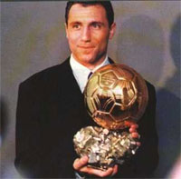
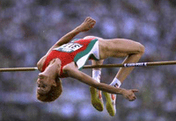

SPORTS SCHOOL GEORGI STOIKOV RAKOVSKI, dobrich, Bulgaria
Notes:
1

Slide 2
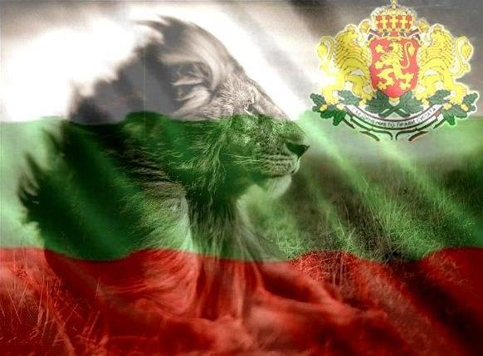
Bulgaria's most
renowned
sports people

Slide 3
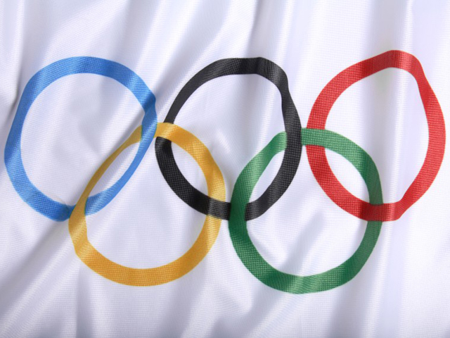
S T E F K A
K O S T A D I N O V A

Slide 4
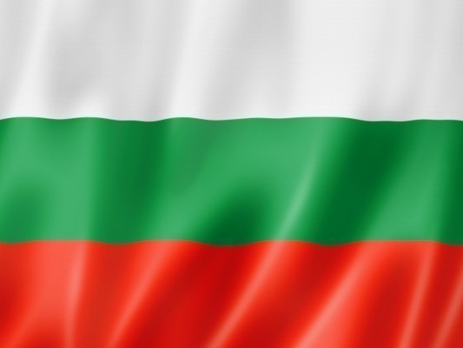
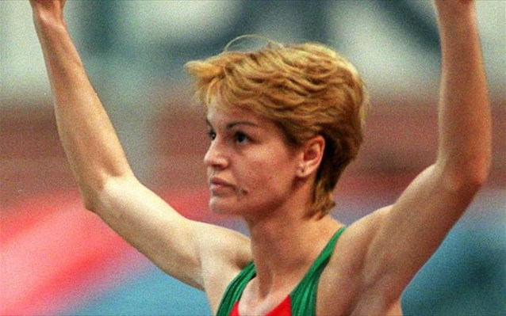
name: STEFKA GEORGIEVA KOSTADINOVA
date and place of birth: 25 March, 1965, town of Plovdiv
Occupation:
high jumper

Slide 5
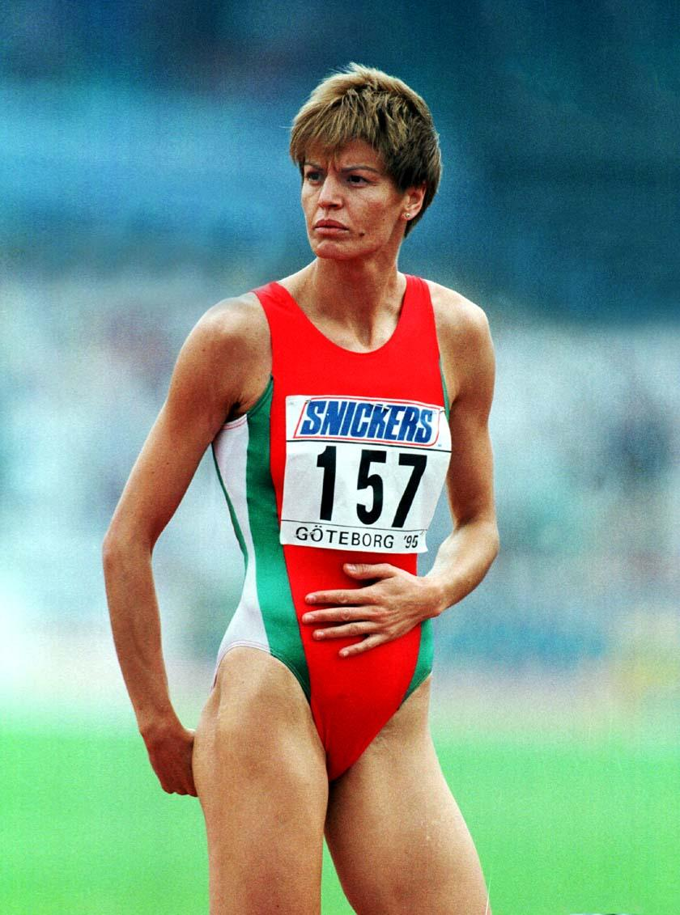
SPORTS ACHIEVEMENTS:
Olympic Champion of Atlanta Summer Olympics Games, 1996
Silver medal of Seoul Summer Olympics Games, 1988

Slide 6
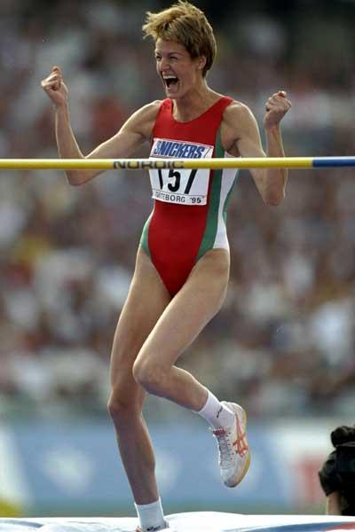
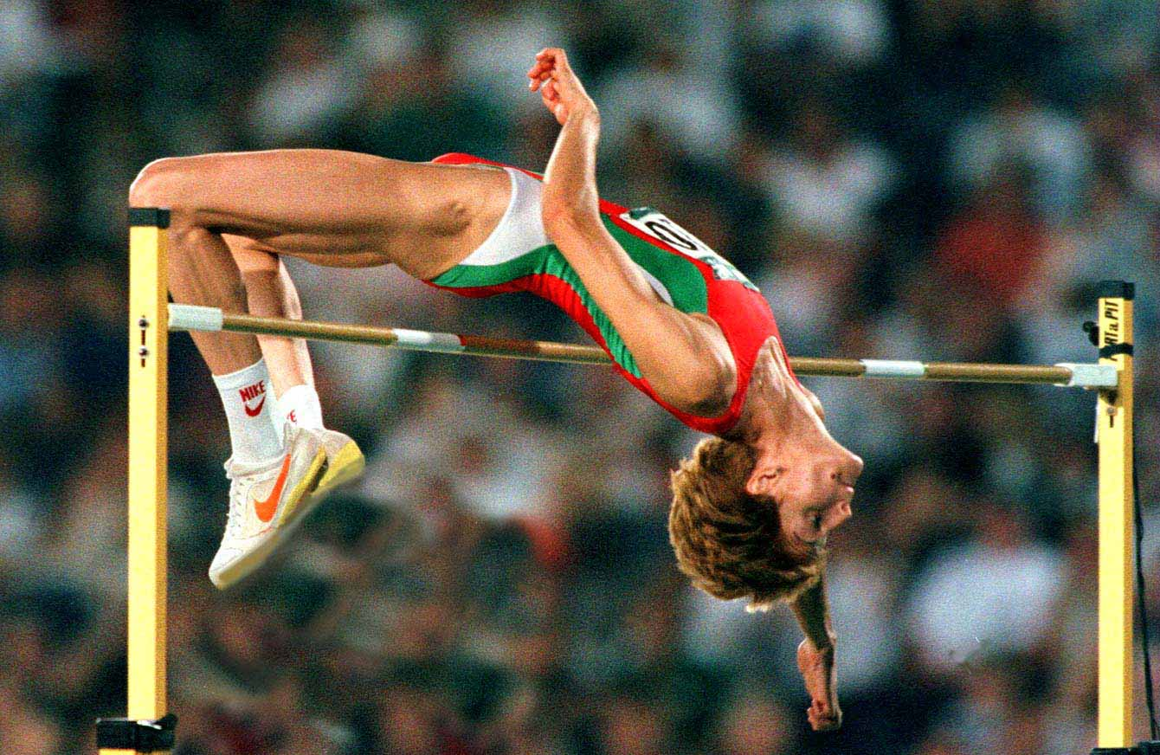
  Two outdoors world titles
  Five indoors world titles
  Four outdoors European titles
  Four indoors European titles

Slide 7
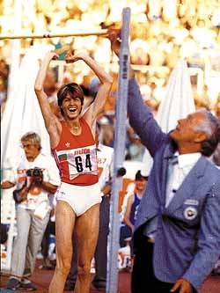
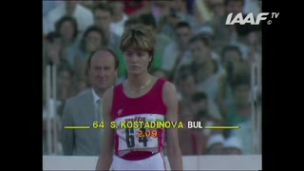
On 30, August, 1987, at World Championship in Rome, Italy, she set a world record, leaving the bar safe at the height at 209 cm!
Since then on
no one has ever beaten it!

Slide 8
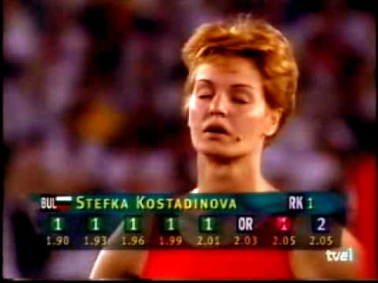
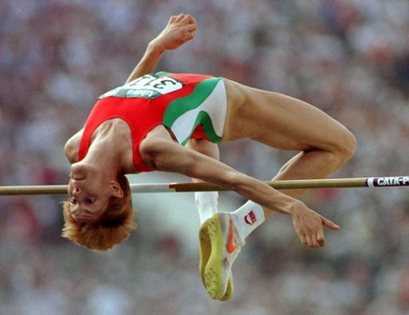
Five times acclaimed as the Balkans’ best sportsperson
Eight times voted into Bulgaria’s three best sportspeople rank
Admitted to World Athletics’ Hall of Fame in 2012

Slide 9
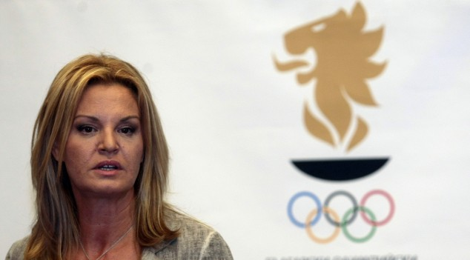
Chairwoman of Bulgaria’s Olympics Committee

Slide 10


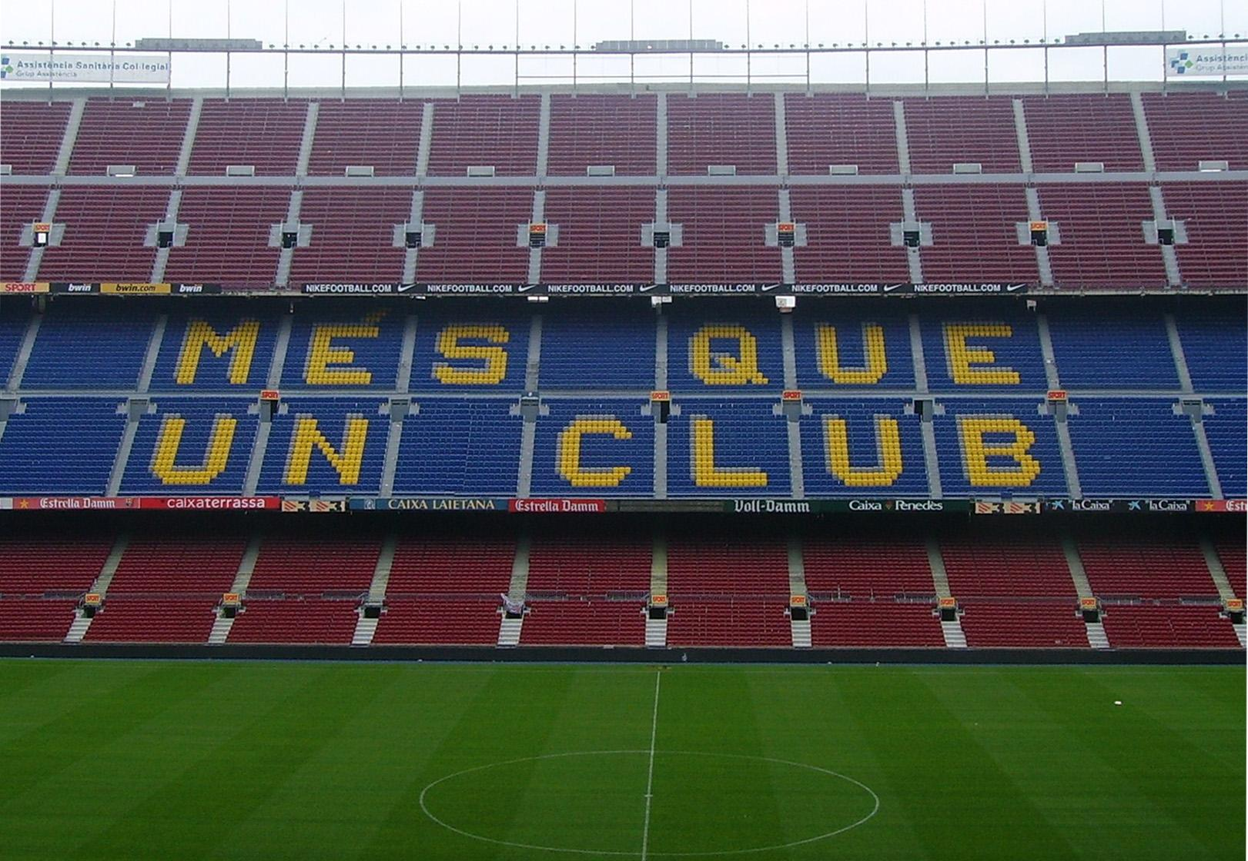
H R I S T O
S T O I C H K O V

Slide 11
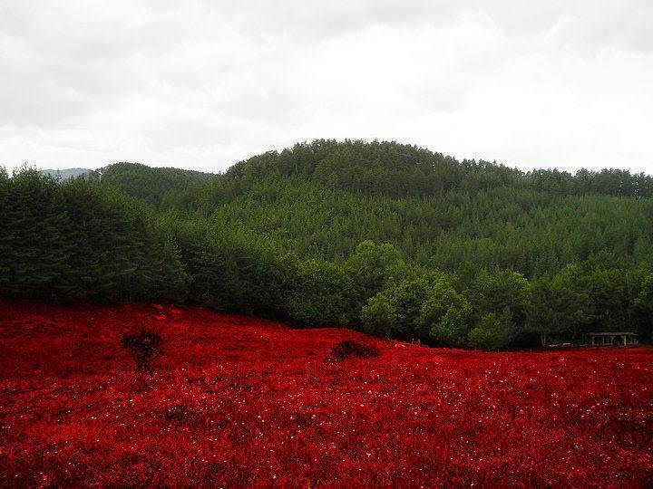
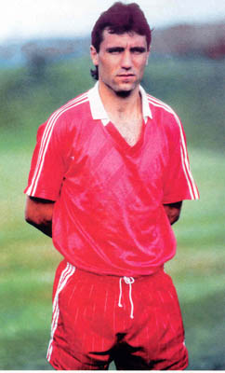
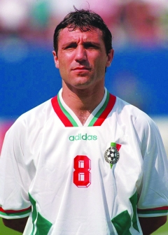
name: HRISTO STOICHKOV STOICHKOV (The Dagger)
date and place of birth: 8 February, 1966, town of Plovdiv
Occupation:
Bulgaria’s most successful football player ever
Bulgaria’s honored consul to Spain
football coach

Slide 12
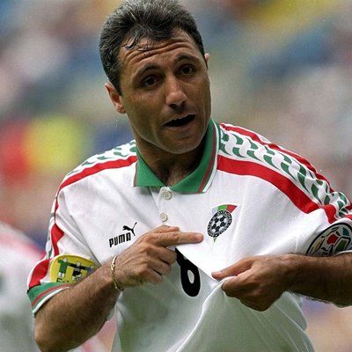
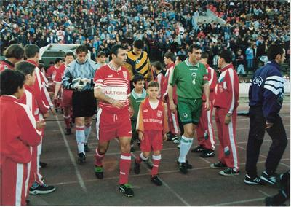
His path to greatness started with the football club of CSKA – Sofia in 1985.
Two years later, in 1987 he made a debut for Bulgarian National Football team.

Slide 13
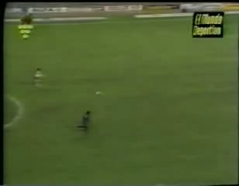
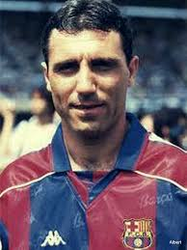
Next, being part of the team of CSKA, he reached the semi-final of UEFA Cup Winners’ Cup in 1989 only to lose to Barcelona.
As a result, he was invited to play for Barcelona and with it he achieved most.

Slide 14
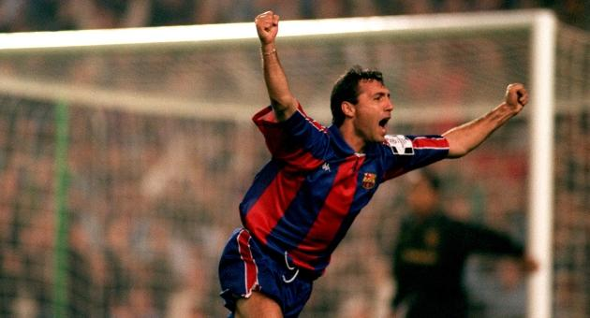
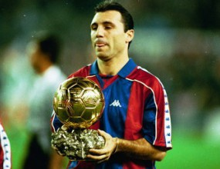
SPORTS ACHIEVEMENTS:
UEFA European Champions’ Cup with Barcelona in 1992
World Ballon d’Or award for the best football player of the year in 1994
Second place at the same rank in 1992

Slide 15
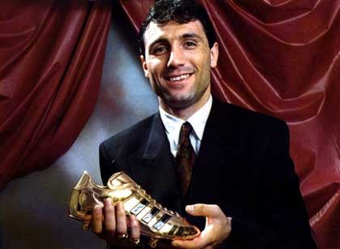
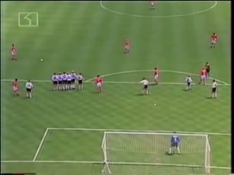
European Golden Boot for the best goalscorer in Bulgaria’s championship with the team of CSKA (38 goals) in 1990
FIFA World Cup’s best goalscorer in USA, 1994
(6 goals)

Slide 16
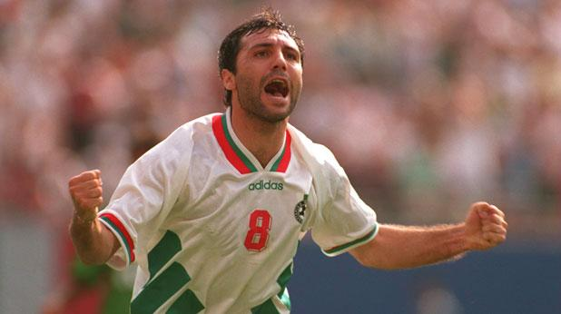
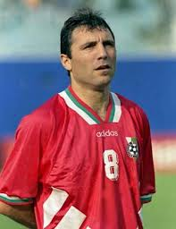
With the team of CSKA:
Three times Bulgarian Championship in 1987, 1989, 1990
Four times Bulgarian Cup in 1985, 1987, 1988, 1989
One Bulgarian Super Cup in 1989
Twice Bulgaria’s best goalscorer in 1989 (23 goals), 1990 (38 goals)
Once UEFA Cup Winners’ Cup best goalscorer in 1989 (7 goals)

Slide 17
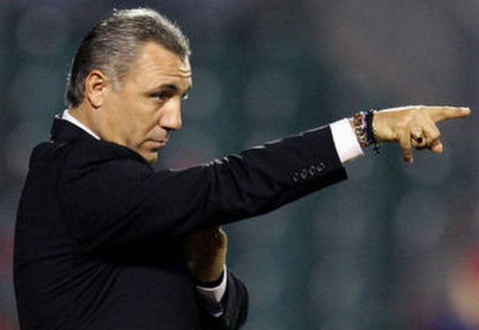
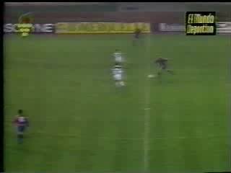
With the team of Barcelona:
Five times Spanish Championship in 1991, 1992, 1993, 1994, 1998
Once UEFA European Champions’ Cup in 1992
Once UEFA Super Cup in 1992
Four times Spanish Super Cup in 1991, 1992, 1994, 1996
Once King’s Cup in 1997
Once UEFA Cup Winners’ Cup in 1997

Slide 18
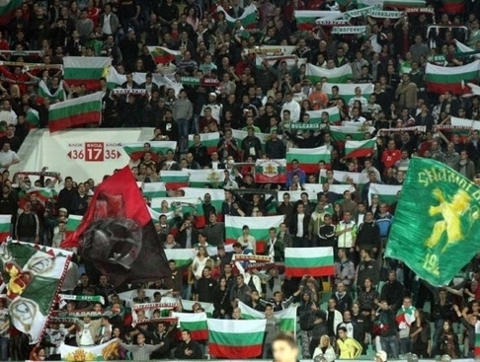
Thank You for
Your Attention

